Slide 1
Sprint 2
Music Trivia Web-based Game

Slide 2
Contents
What I did?
What’s next?

Slide 3
What I did?
Wireframe
Setup backend and frontend environment
CRUD functionalities backend
Create UML class diagram for user
Setup CI pipeline

Slide 4
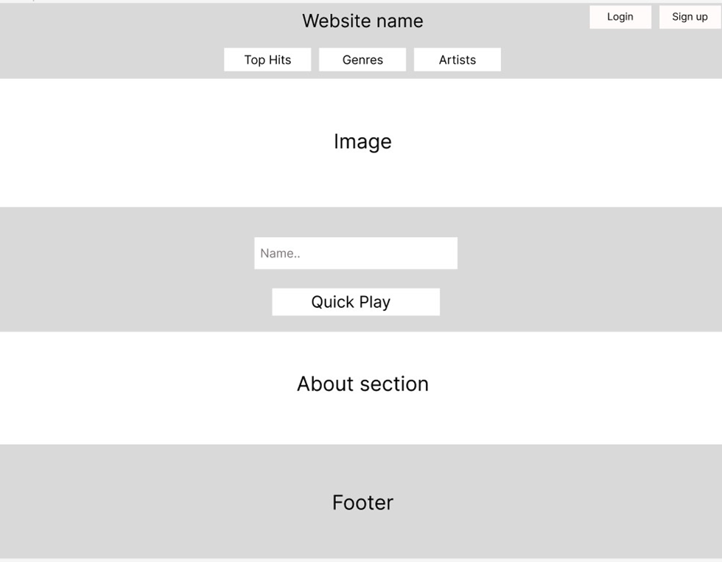
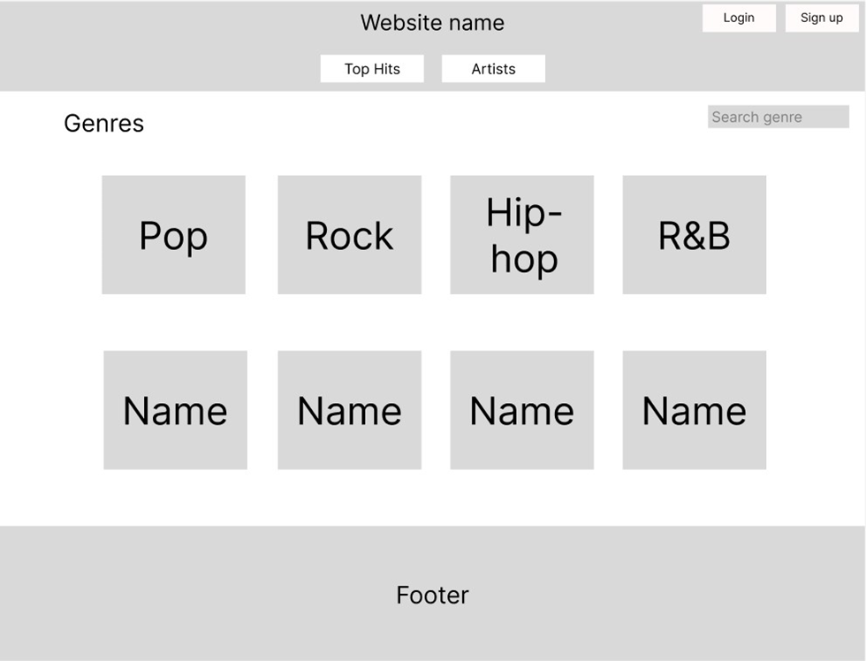
Wireframe

Slide 5
CRUD functionalities backend

Slide 6
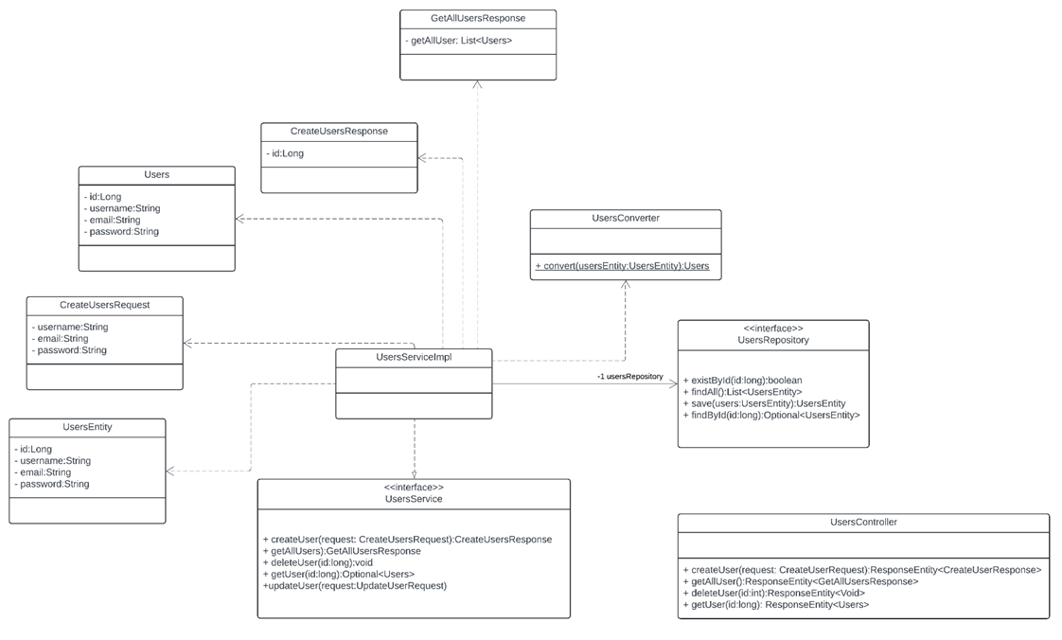
Create UML class diagram for user

Slide 7
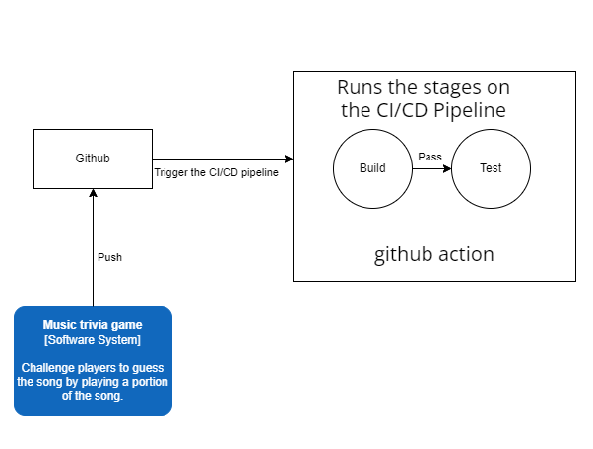
Setup CI pipeline

Slide 8
What’s next
Create test plan.
Create unit tests.
Add docker to CI pipeline
Implement authentication and authorization.
Do research question 1 and 2.

Slide 9

Thank you

